Slide 1





Registration
form

Slide 2



The Team
Team Leader
MANIK LAKHANPAL 2310992142
Co Team Members
SUJAL GARG
2310992143
NAMAN SINGH
2310992160
OJASV JINDAL
2310992169

Slide 3
Project Overview
A registration form is used to collect essential information from users to create their accounts or profiles. It typically includes fields for name, email, password, and contact details. This form ensures secure access, personalized services, and helps maintain accurate user records. By filling out the registration form, users can gain access to exclusive features, updates, and a tailored experience.

Slide 4

Tech Stack
Frontend
Backend
Database
HTML: Structure, Layout, Elements, Content
CSS: Style, Design, Colors, Responsiveness
JavaScript: Server, API, Node.js,
DOM
JSON Files: Data, Storage, Transfer, Format, Configuration

Slide 5

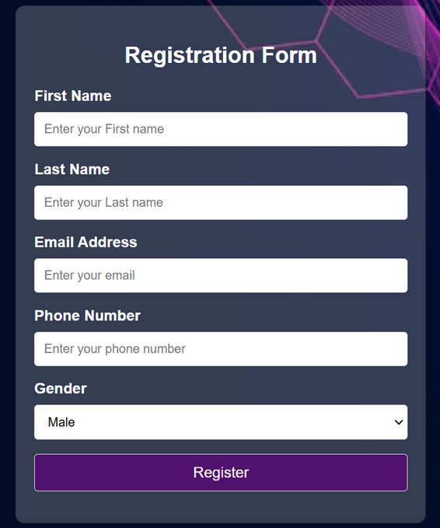
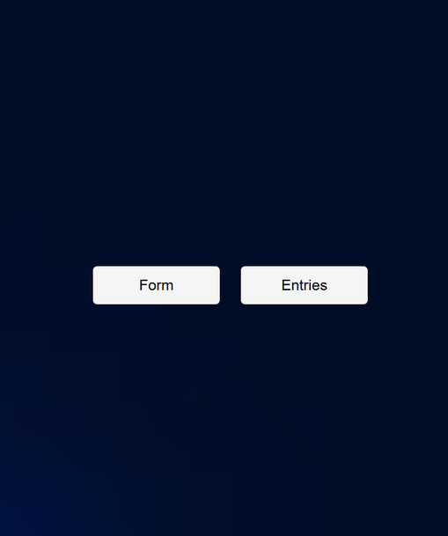
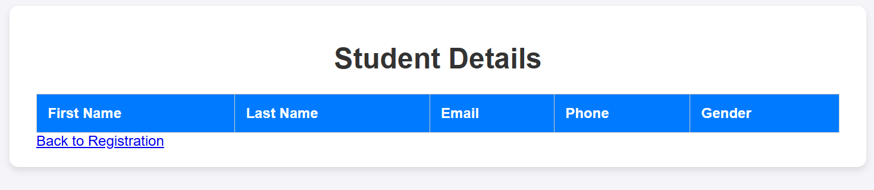

Result

Slide 6

Thank You

